Slide 1
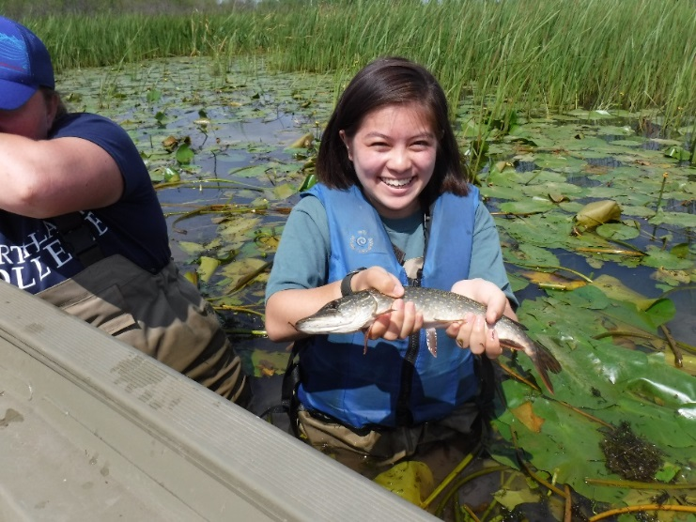
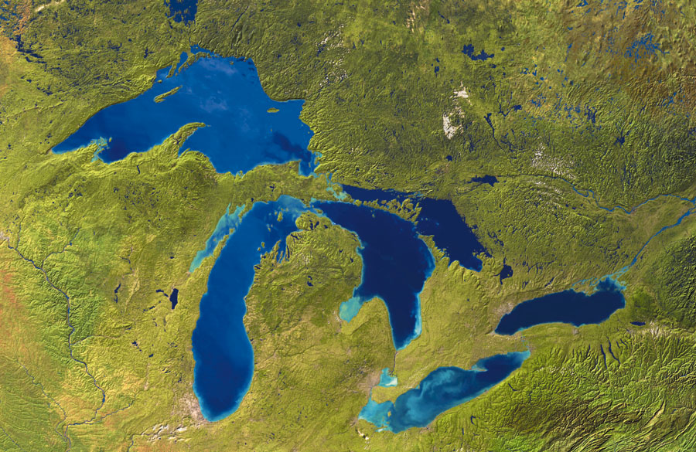
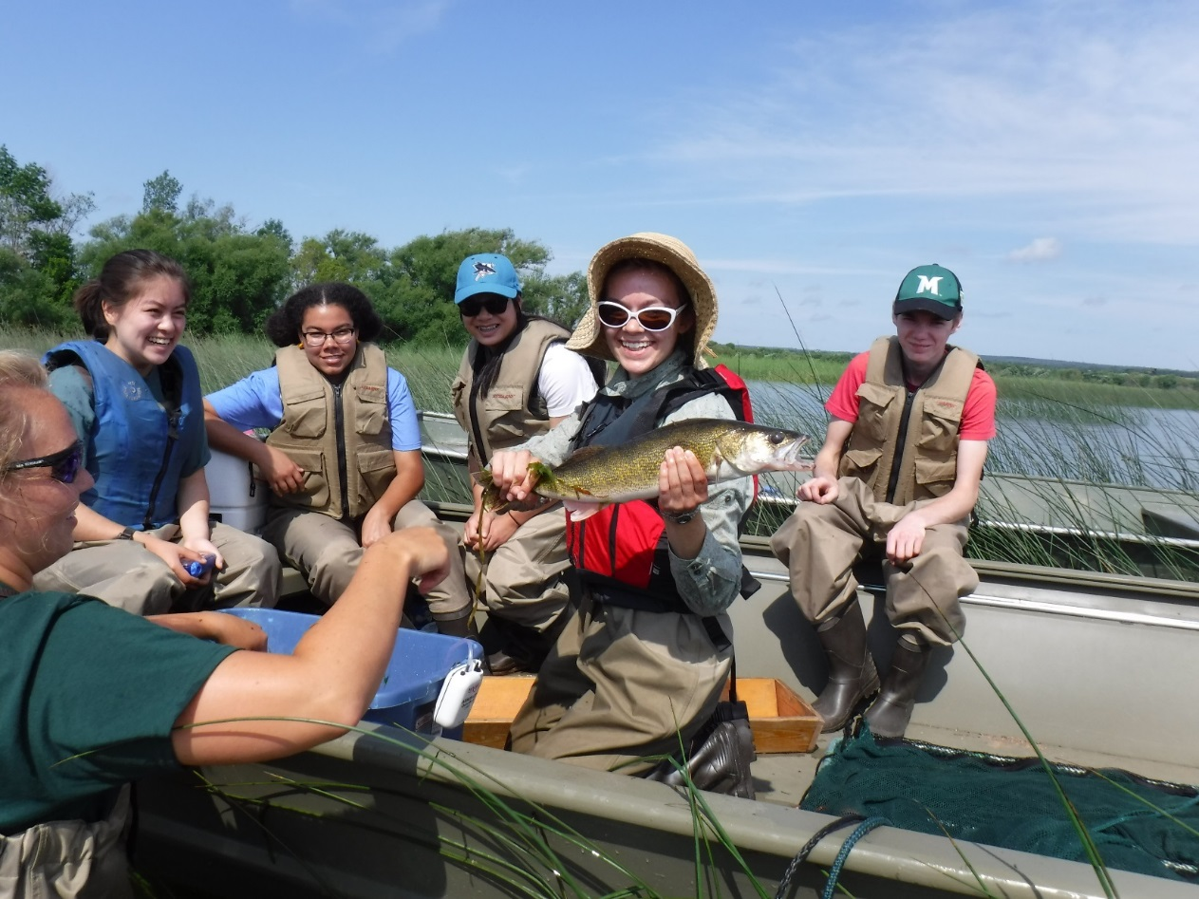
Fish in Great Lakes Coastal Wetlands
Dr. Matthew Cooper
Fisheries Science and Management
January 30, 2018

Slide 2
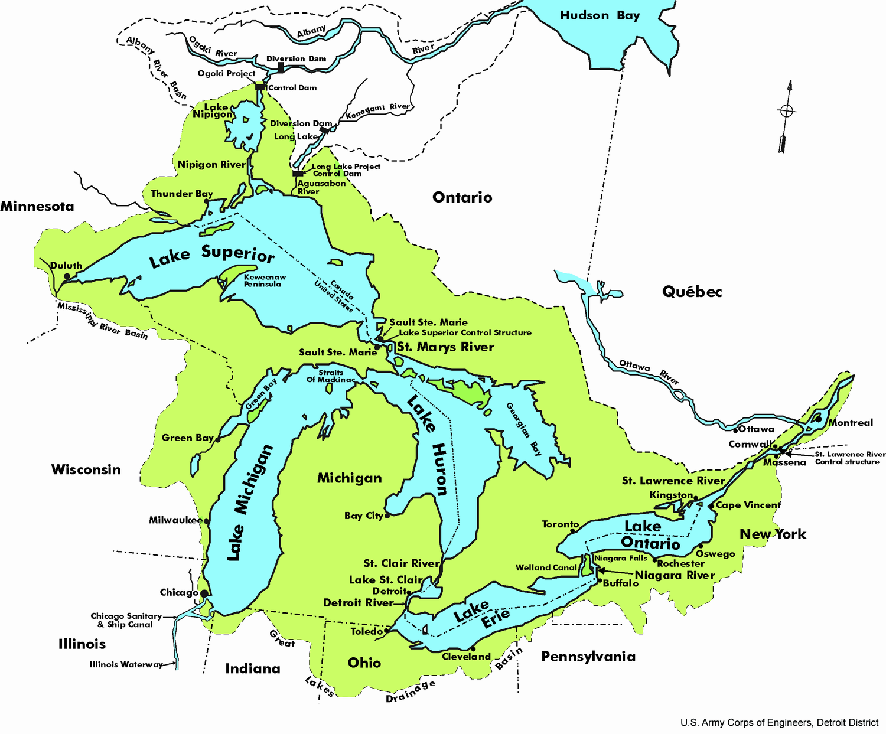
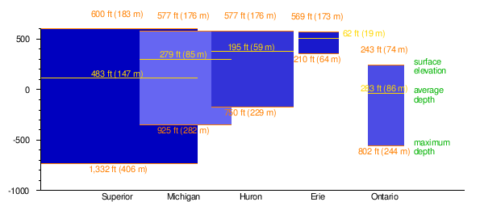
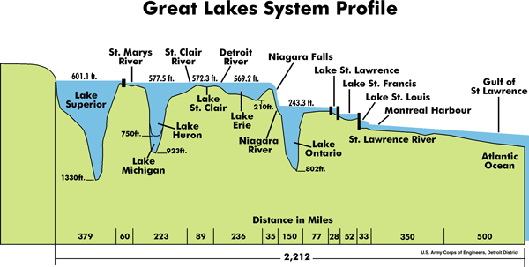

Slide 3
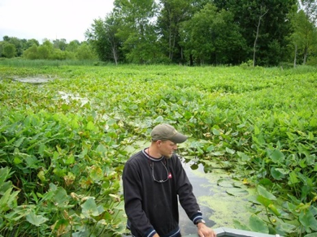
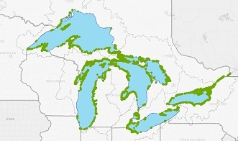
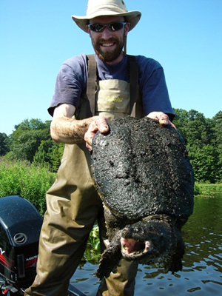
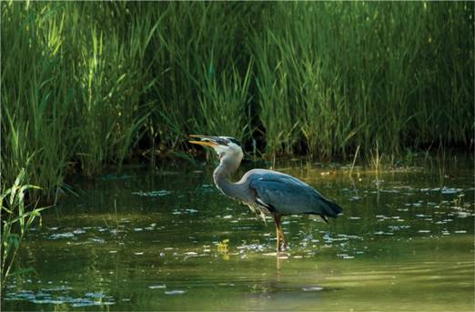
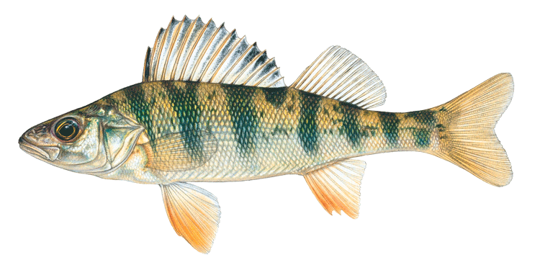
Great Lakes Coastal Wetlands
Approximately 2,000 coastal wetlands basin-wide
What makes a wetland a wetland?
What makes a wetland “coastal?”

Slide 4
Great Lakes Coastal Wetlands
Most productive habitats in the Great Lakes

Slide 5
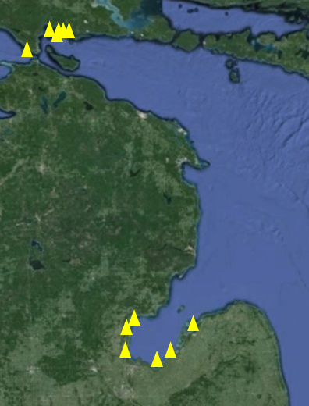
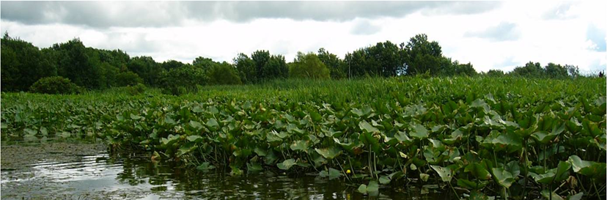
Great Lakes Coastal Wetlands: high primary productivity
2007-2008
GPP
(mmol O₂ m⁻² D⁻¹)
R
Bay Port
Mismer
North
Search
Voight
Cedarville
Mackinaw
Wigwam
St. Ignace
Pinconning
Vanderbilt
Bradleyville
Cooper et al. 2013 Limnology and Oceanography, 58(2)

Slide 6
Great Lakes Coastal Wetlands
Trap and remove sediment and nutrients
Buffer shorelines from wave energy
Aesthetic and cultural resource
Critical fish nursery habitat

Slide 7
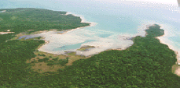
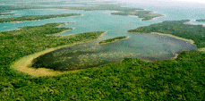
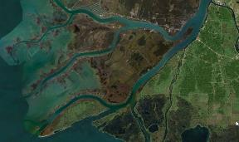
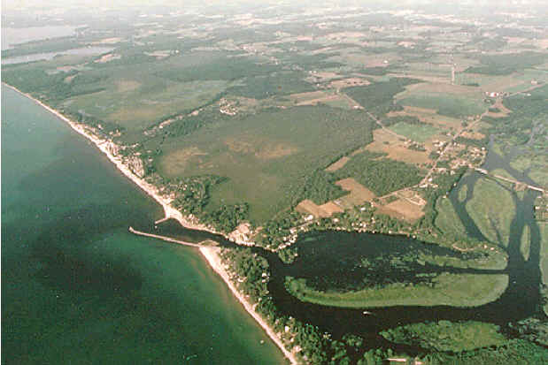
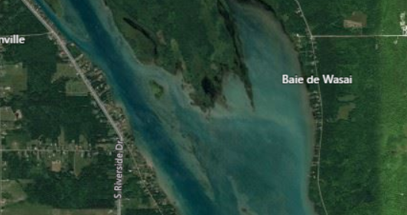
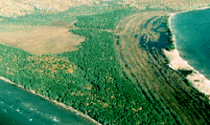
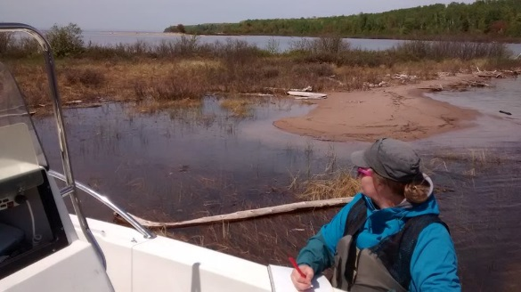
Great Lakes Coastal Wetland Types
Lacustrine (or “embayment”)
Riverine
Open
Protected
Delta
Drowned river mouth
Connecting channel
Barrier-protected

Slide 8
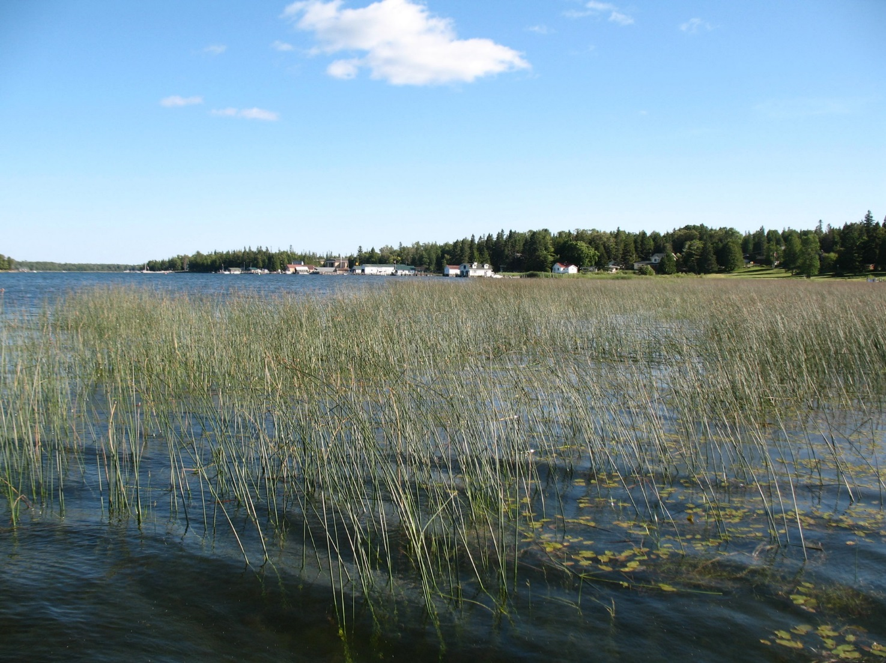
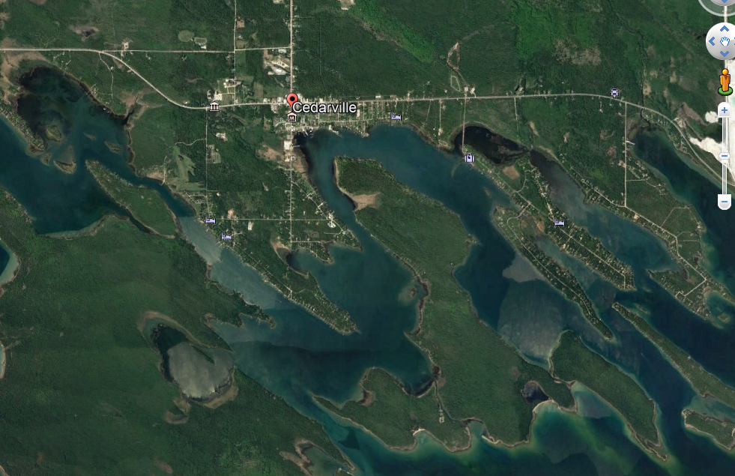
Protected Embayment Wetland
Cedarville Bay, MI
Northern Lake Huron

Slide 9
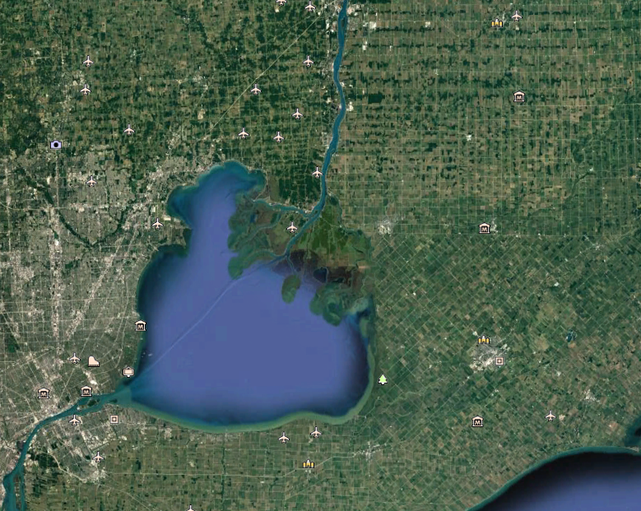
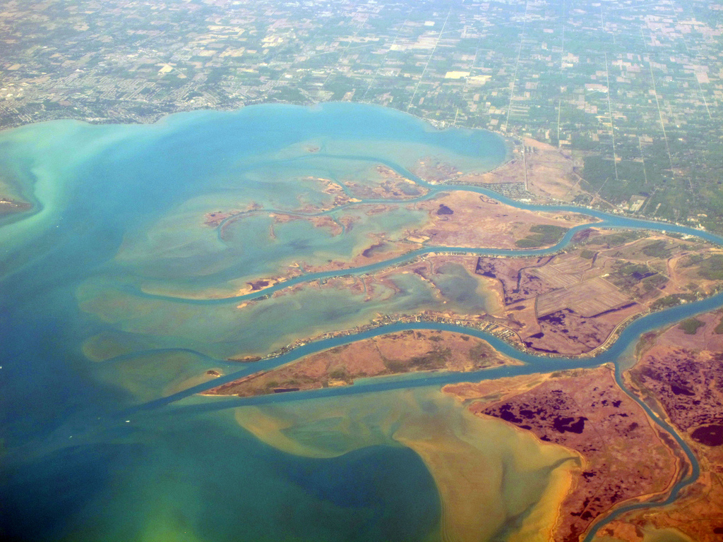
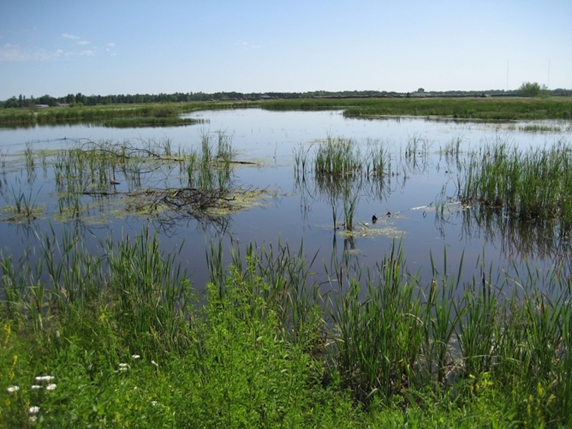
Riverine wetland
St. Clair River Delta

Slide 10
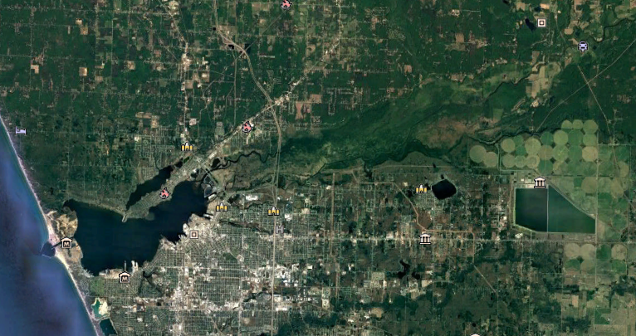
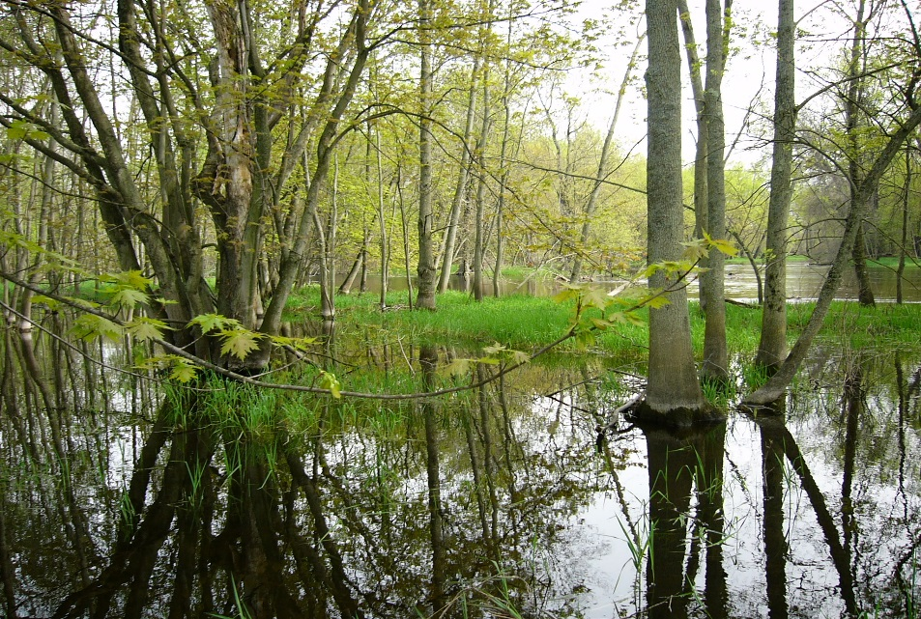
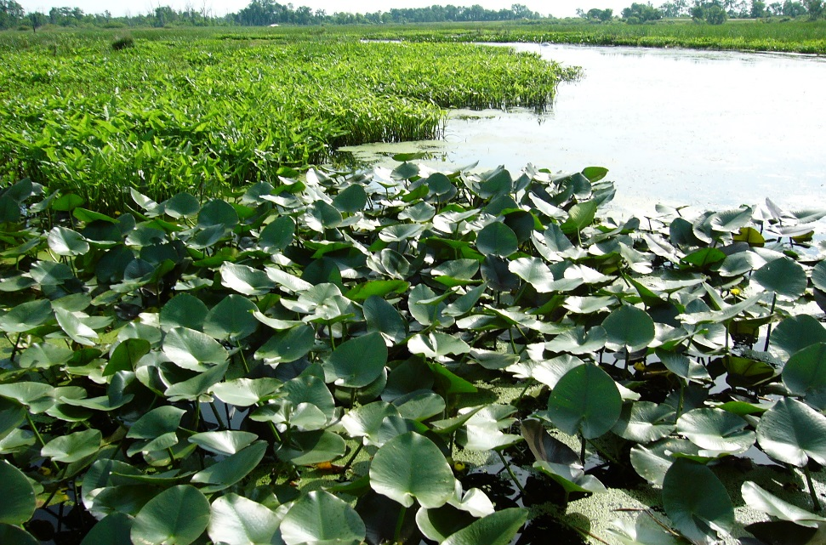
Drowned River Mouth Wetland
Muskegon River, MI
Eastern shore of Lake Michigan
Marsh
Great Lakes Coastal

Slide 11
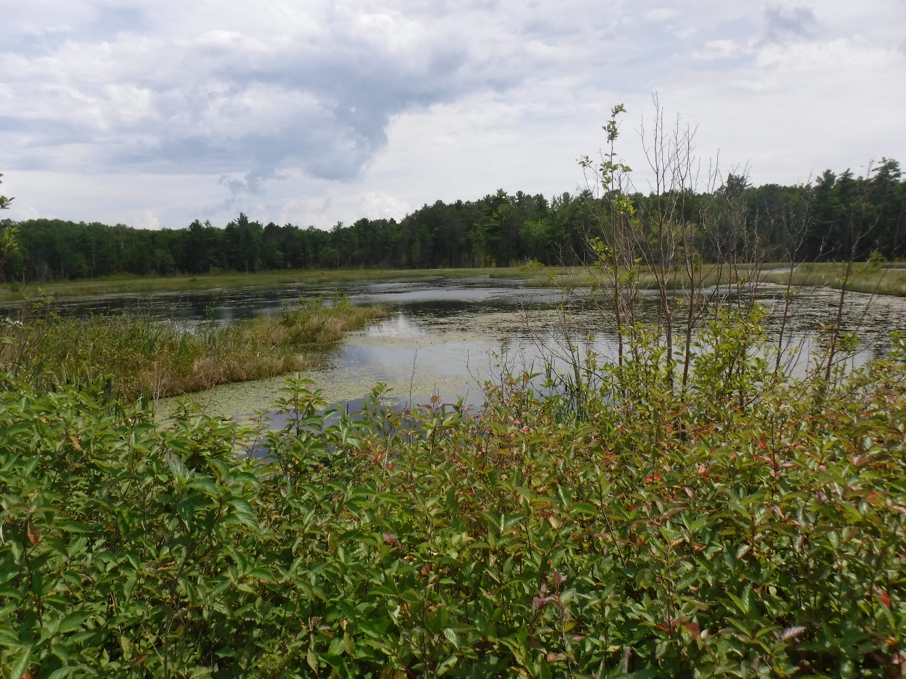
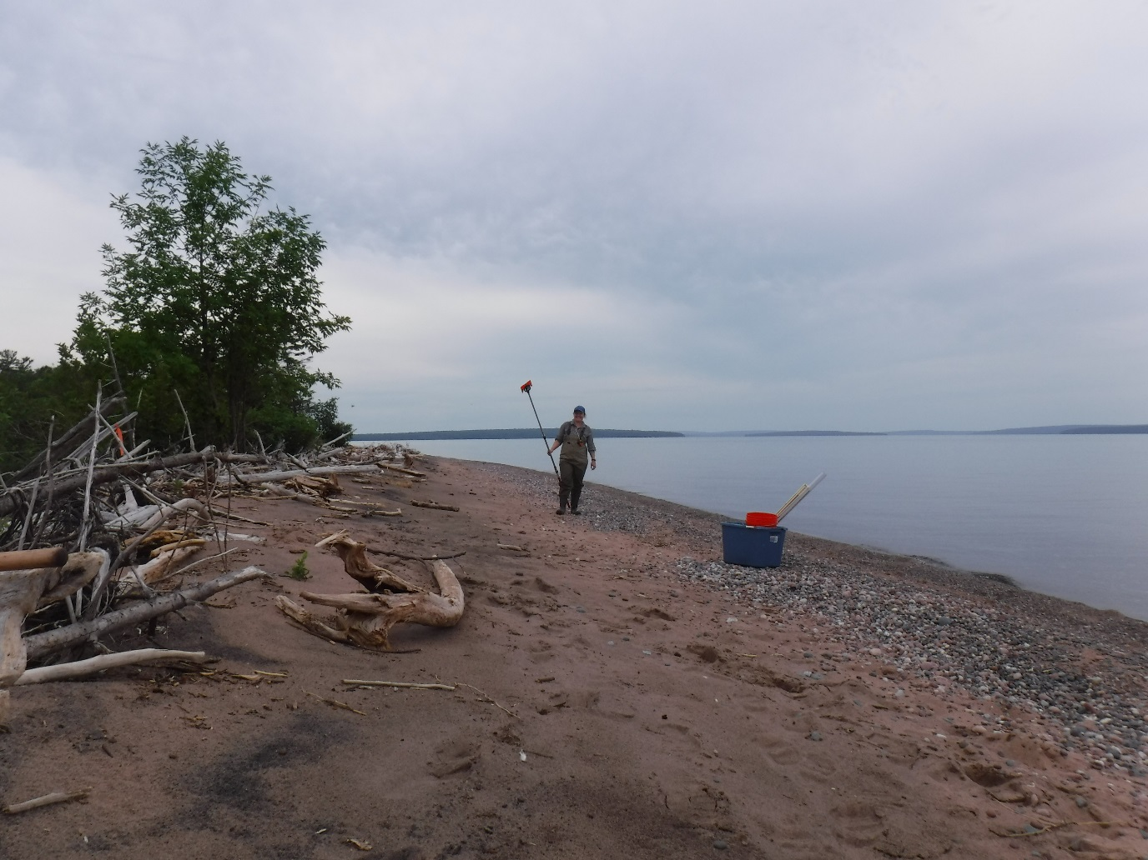
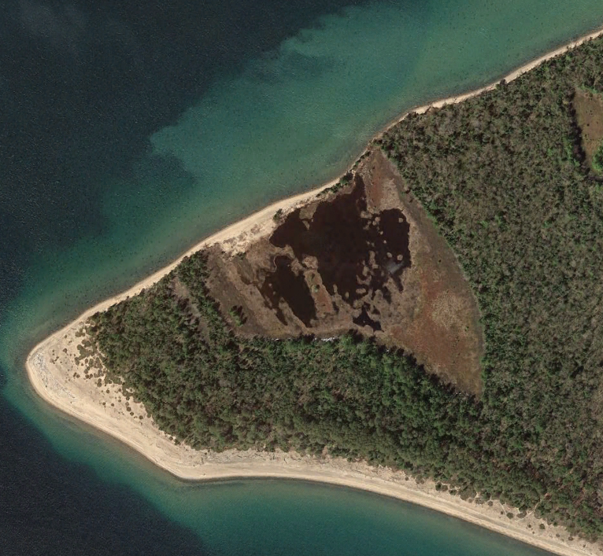
Barrier-protected wetlands
Michigan Island lagoon
Marsh
Great Lakes Coastal

Slide 12
Coastal wetlands are “gradient ecosystems”
Impacts from the landscape
Impacts Diluted
Advected from open water
Shrub Swamp
Wet Meadow
Emergent
“Strand” zone
(Cattail)
Emergent
(Bulrush)
Submersed Aquatic Veg.

Slide 13
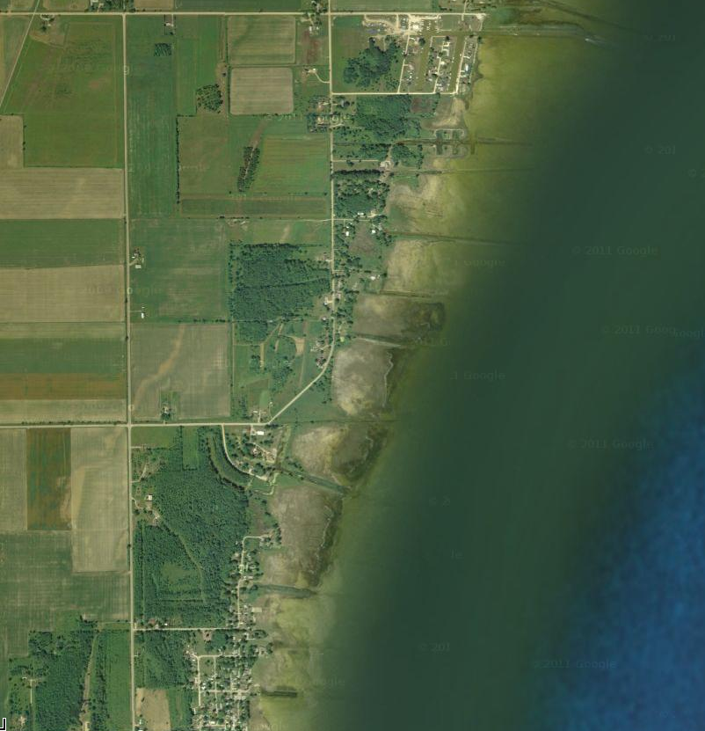
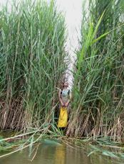
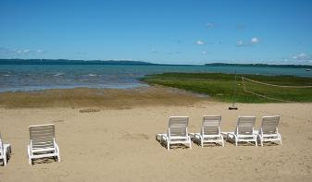
Great Lakes Coastal Wetlands: Impacts
Loss: ~50% basin-wide
Nutrient loading
Invasive species
Habitat fragmentation
Hydrologic manipulation
Altered nearshore hydrology/sediment

Slide 14
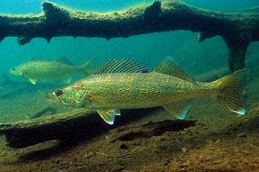
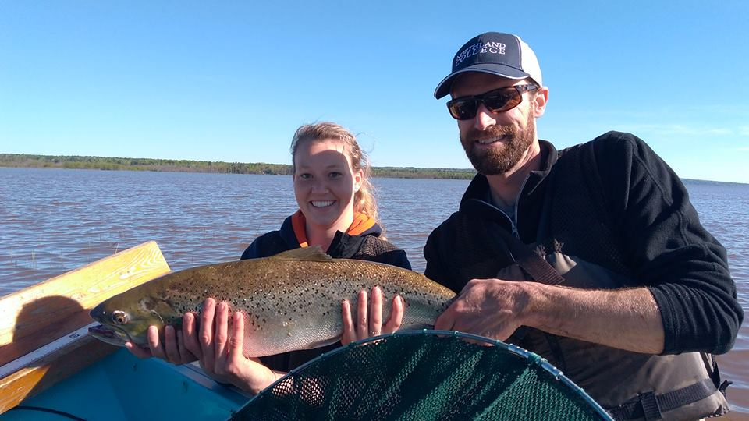
Fish in Great Lakes coastal wetlands
GL Coastal Wetland Monitoring Program: 95 species collected over 5 years
Species Richness
Lowest in Lake Erie: 8.9±0.7
Highest in Lake Superior: 10.3±0.6
Spawning and nursery habitat
Feeding forays
Warm water residents
Understanding fish use of GLCW is an interesting and evolving science!
http://greatlakeswetlands.org/Home.vbhtml

Slide 15
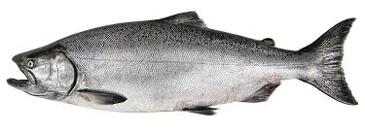
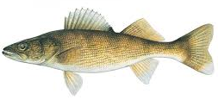
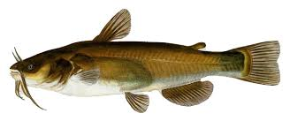
Fish in Great Lakes coastal wetlands
Coastal wetlands support a variety of Great Lakes fish species
Great Lakes
open water
species
Open water – wetland
transitional species
Truly wetland species
Cool-cold water
fishes
Lake herring
Lake whitefish
Trout and salmon
Cool-warm water
fishes
Walleye
Smallmouth bass
Yellow perch
Warm water
fishes
Brown bullhead
Mud minnow
Common carp
Very occasional visitors
Regular visitors, residents
Wetland residents

Slide 16
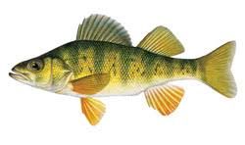
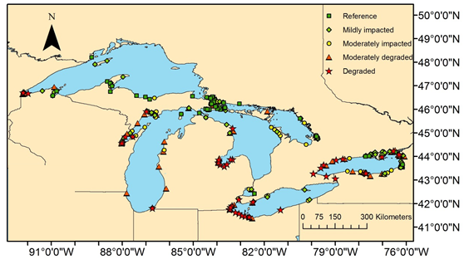
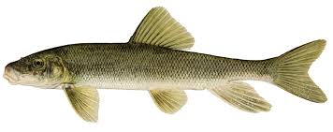
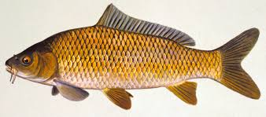
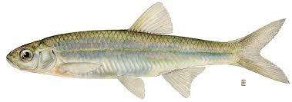
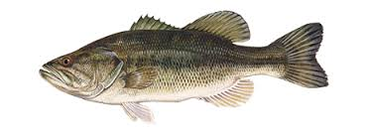
Fish in Great Lakes coastal wetlands
GLCWMP data (2011-2015)
325 wetlands sampled across Great Lakes Basin
>700,000 fish caught
Majority YOY and age-1
Yellow perch
Brown bulhead
White sucker
Common carp
Emerald shiner
Largemouth bass

Slide 17
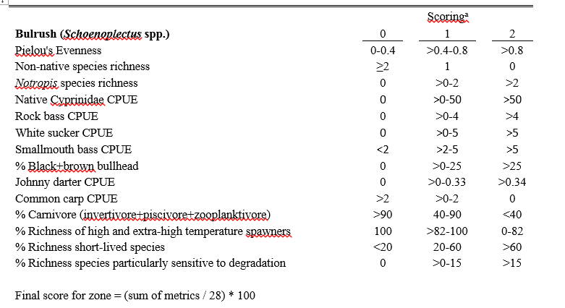
Fish are used in Indices of Biotic Integrity in GL Coastal Wetlands

Slide 18
IBI scores for fish in GL Coastal Wetlands…

Slide 19
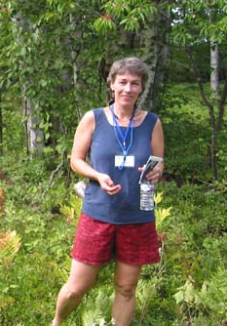
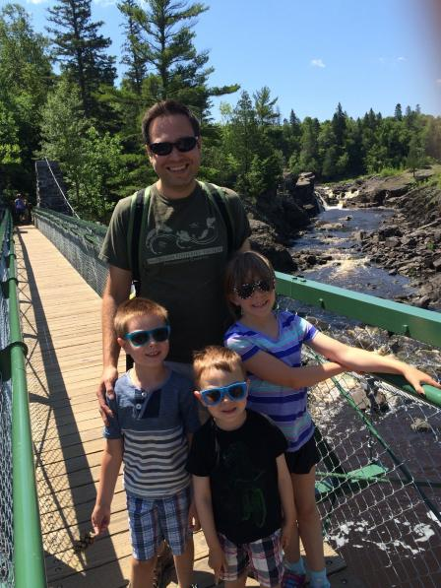
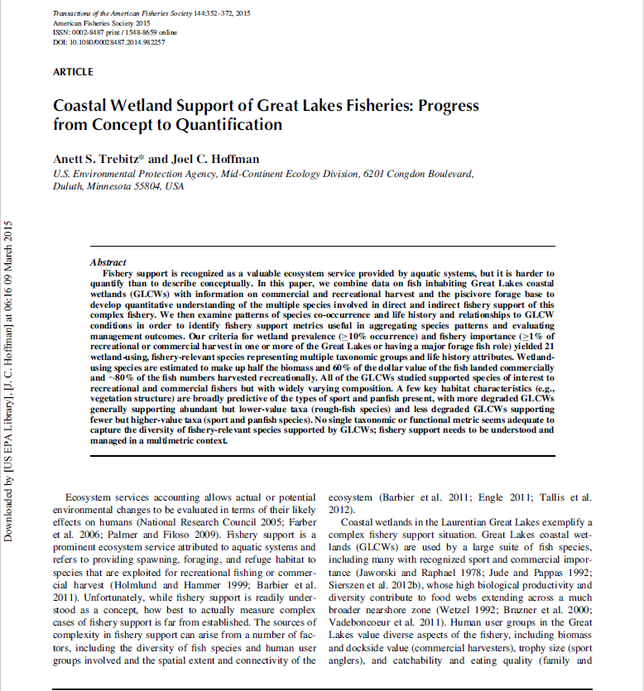
Anett Trebitz and Joel Hoffman, 2015
US EPA Mid-Continent Ecology Lab, Duluth, MN
“Coastal Wetland Support of Great Lakes Fisheries:
Progress from Concept to Quantification”
Transactions of the American Fisheries Society
II. Identify Big Question
III. Summarize background…
IV. Identify specific questions…
V. Summarize methods
VI. Results
VIII. Discussion

